Slide 1


Slide 2

Airport Management
System

Slide 3
Group Members Introduction
Write your group members introduction here with names and VU Id

Slide 4

INTRODUCTION OF PROJECT
  This project involves the design and development of a comprehensive Airport Management System aimed at streamlining various airport operations.
  The system integrates functionalities to manage flights, passengers, tickets, and baggage efficiently.
  It provides a user-friendly interface for staff and passengers, enhancing operational efficiency and user experience.

Slide 5
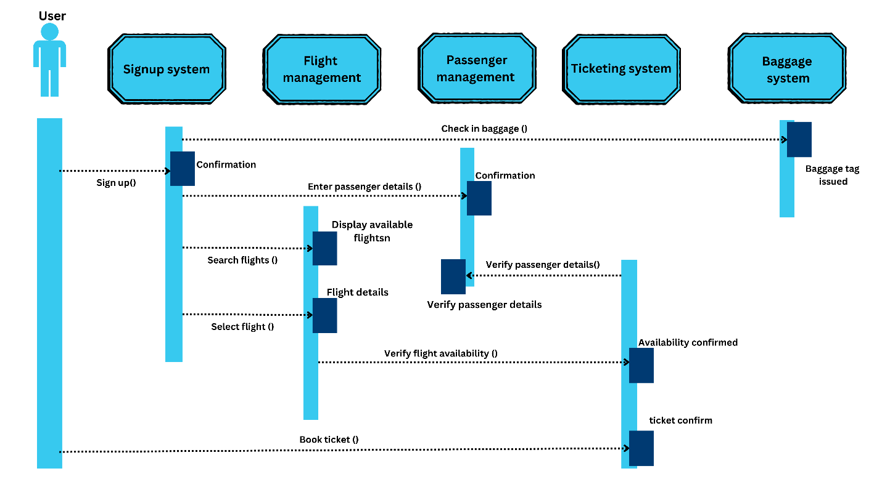
Process Model

Slide 6
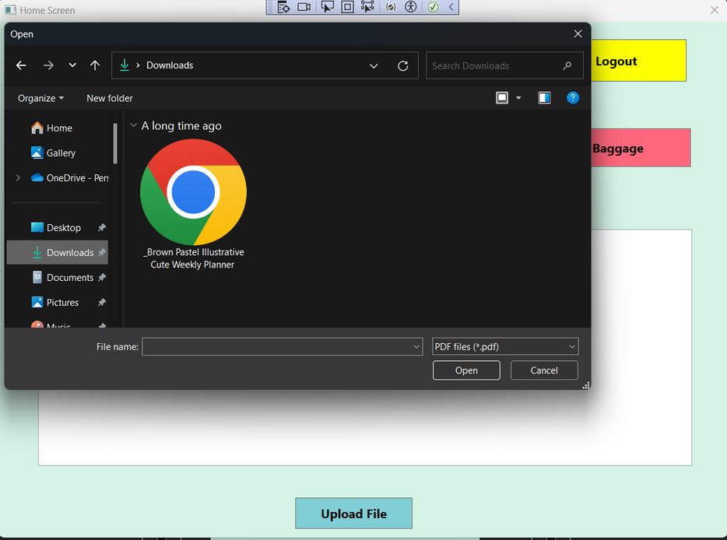
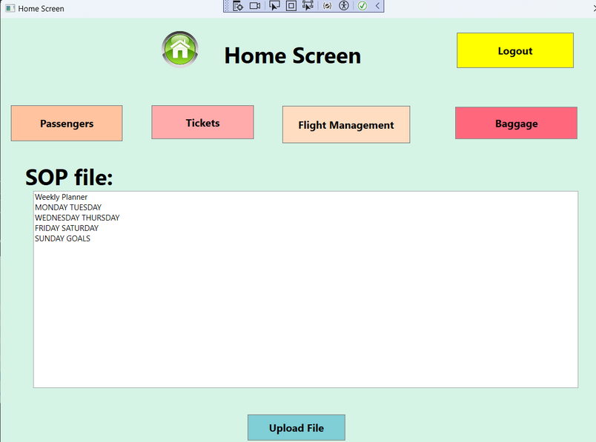
Use Case Diagram
FILE UPLOAD FEATURE
By clicking the upload button you can browser to the files to be uploaded. The content of the file will be displayed in the text field

Slide 7
Business Rules Catalog
  Design and develop an efficient airport management system that simplifies and automates airport operations.
  To ensure accurate and real-time data management for flights, passengers, tickets, and baggage.
  To create a scalable and robust system capable of handling the growing demands of airport operations.

Slide 8
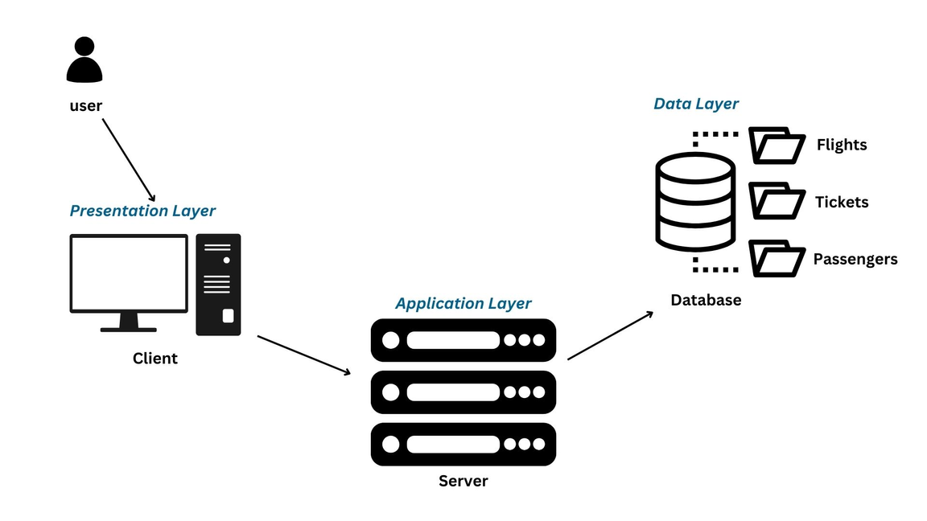
Architectural Design
Presentation Layer: User interface for client interactions
Application Layer: Core logic and processing on the server
Data Layer: Storage and management of data (Flights, Tickets, Passengers)

Slide 9
Team Structure
Provide here the diagrammatic view of your team structure and key responsibilities.

Slide 10
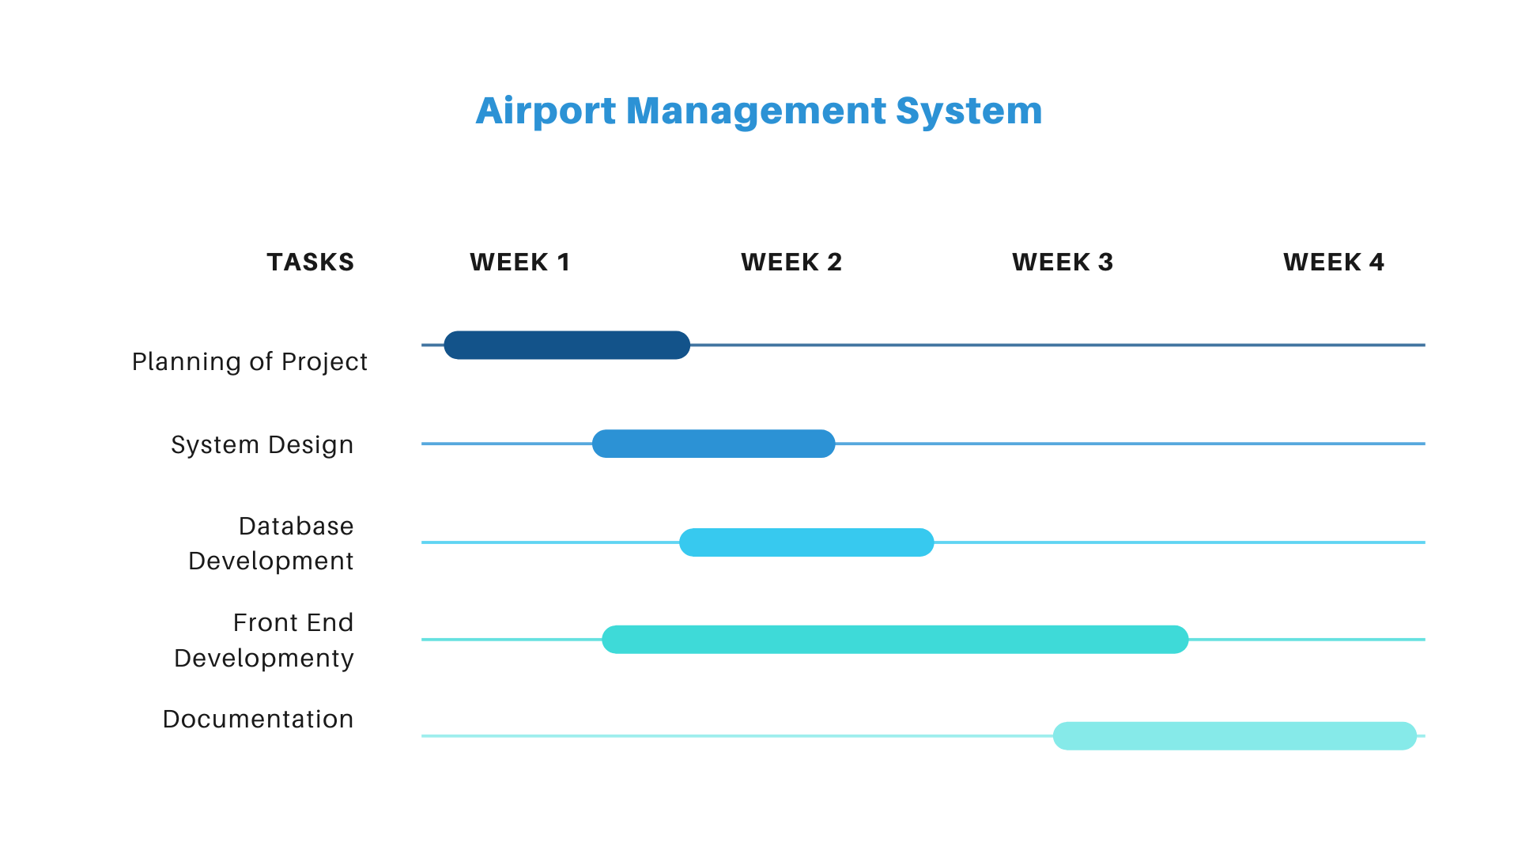
Project Schedule

Slide 11
Sequence Diagrams

Slide 12
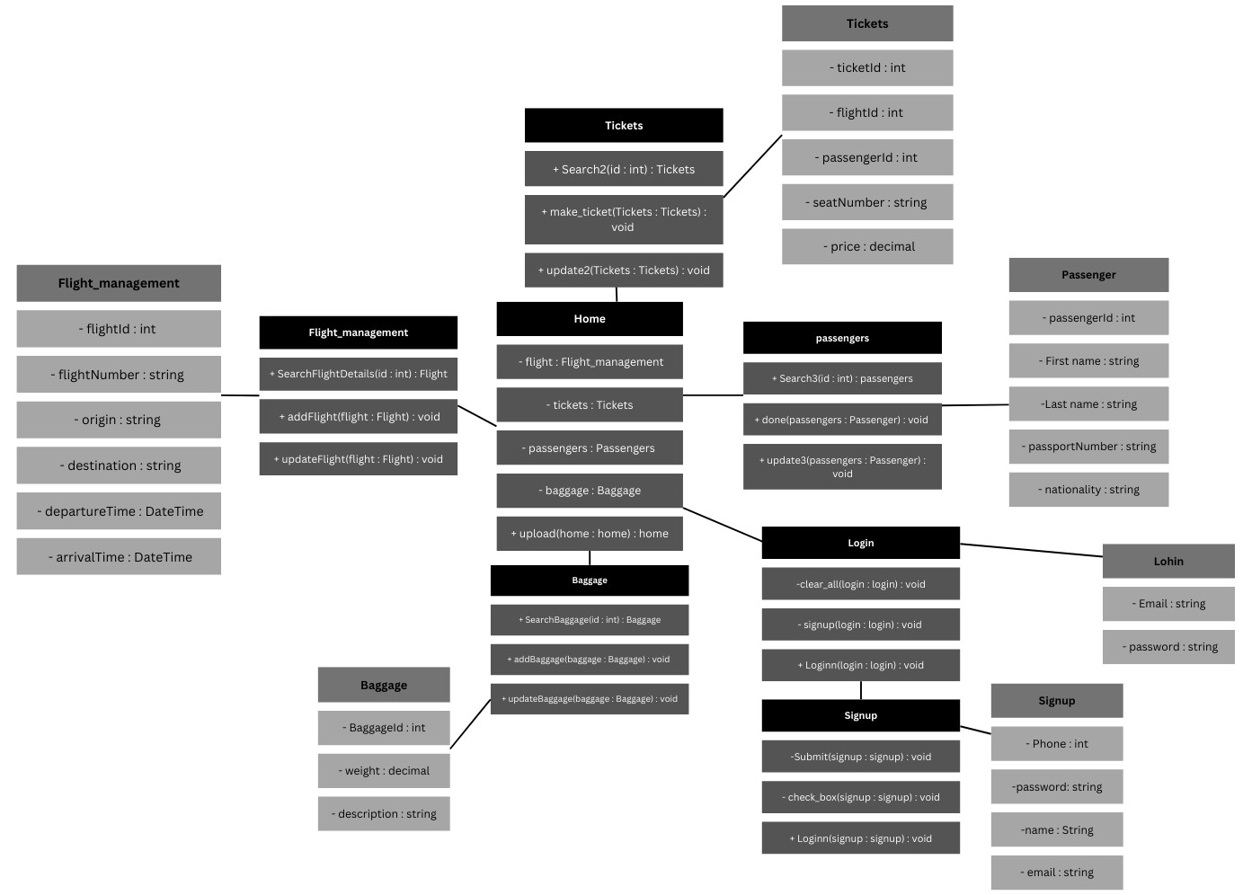
Logical Model/Class Diagram

Slide 13
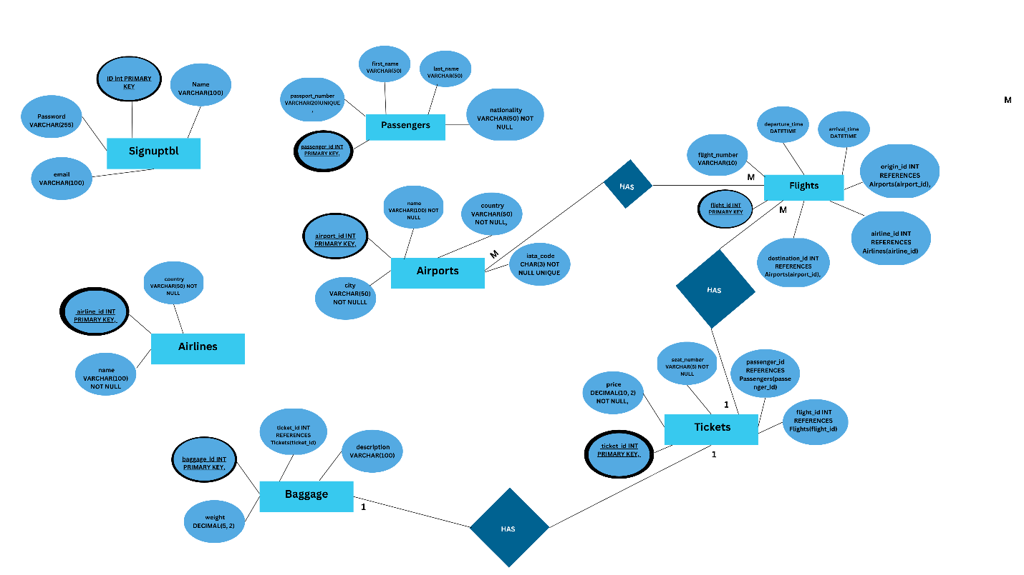
Entity-Relationship Diagram

Slide 14
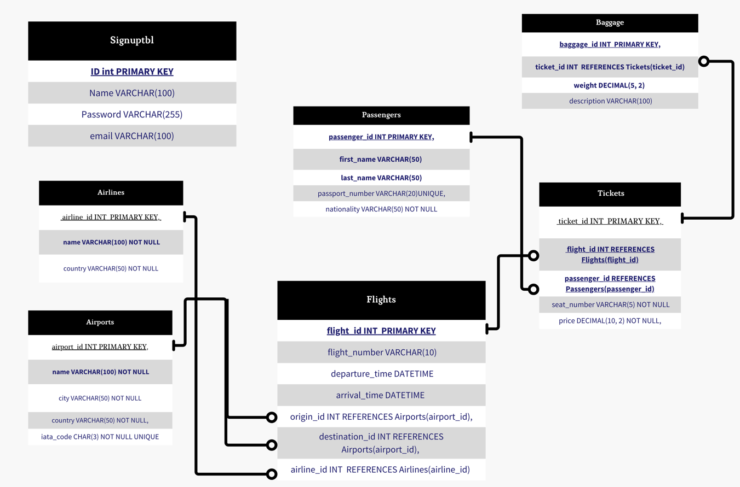
Database Diagram

Slide 15
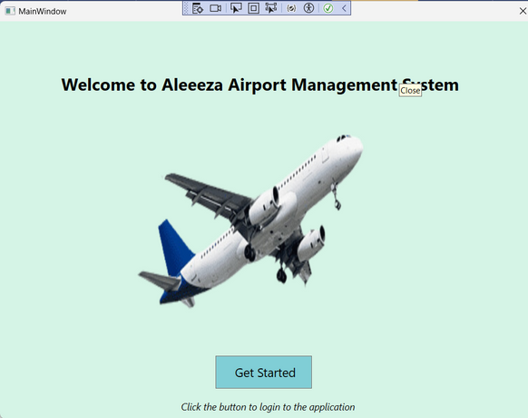
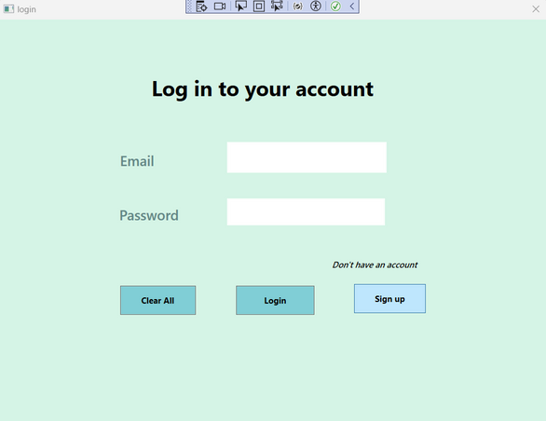
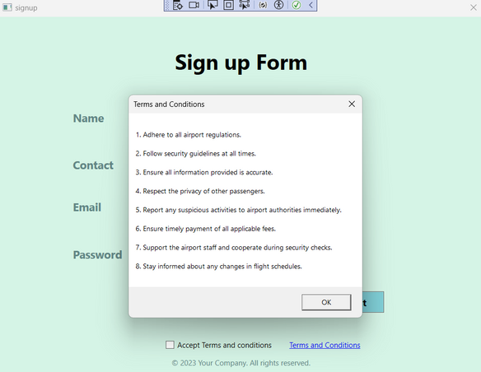
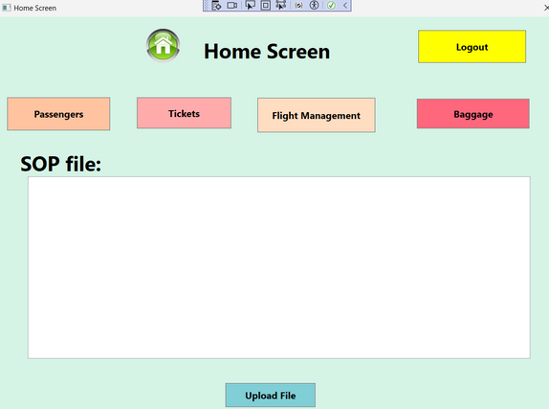
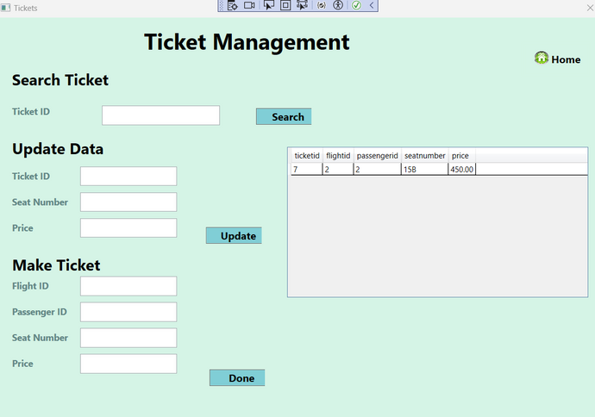
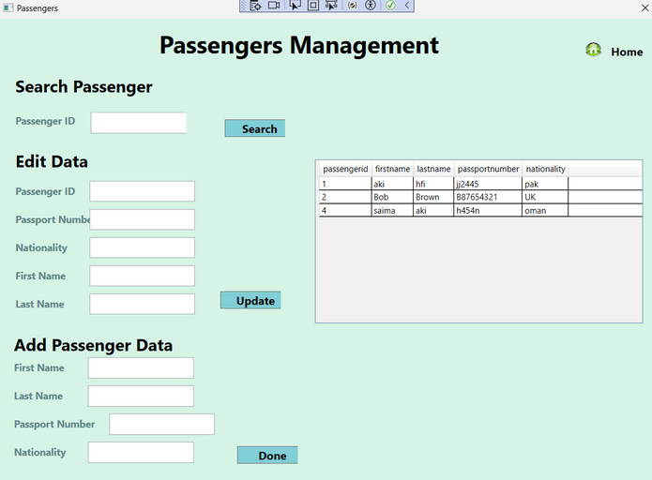
User Interfaces

Slide 16
Tools
  WPF: For designing the user interface and providing a rich, interactive user experience.
  C#: The primary programming language used for backend logic and operations.
  iText7: For extracting and processing content from PDF files.
  DocX: For handling Word document manipulations.
  System.IO: For managing file input/output operations.
  MS SQL Database: For managing and querying the airport management system's data.
  SQL Database: Structured Query Language (SQL) database is used for storing and managing data for the airport management system.

